Slide 1
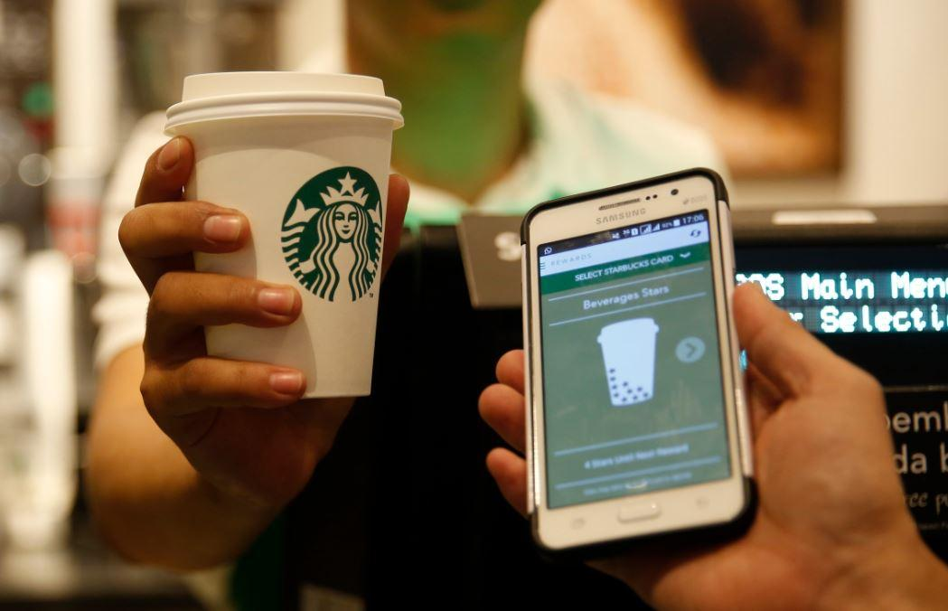
StarBucks App
A synopsis of the food app, from one of the leading coffee restaurants in the world

Slide 2
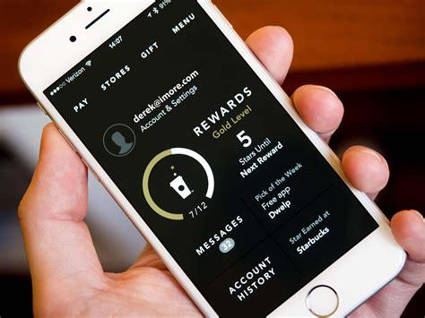
A Bit About The App
Their story began in 1971. Back then they were a roaster and retailer of whole bean and ground coffee, tea and spices with a single store in Seattle’s Pike Place Market. Today, Starbucks is privileged to connect with millions of customers every day with exceptional products and more than 30,000 retail stores in 83 markets. To say Starbucks purchases and roasts high-quality whole bean coffees is very true

Slide 3
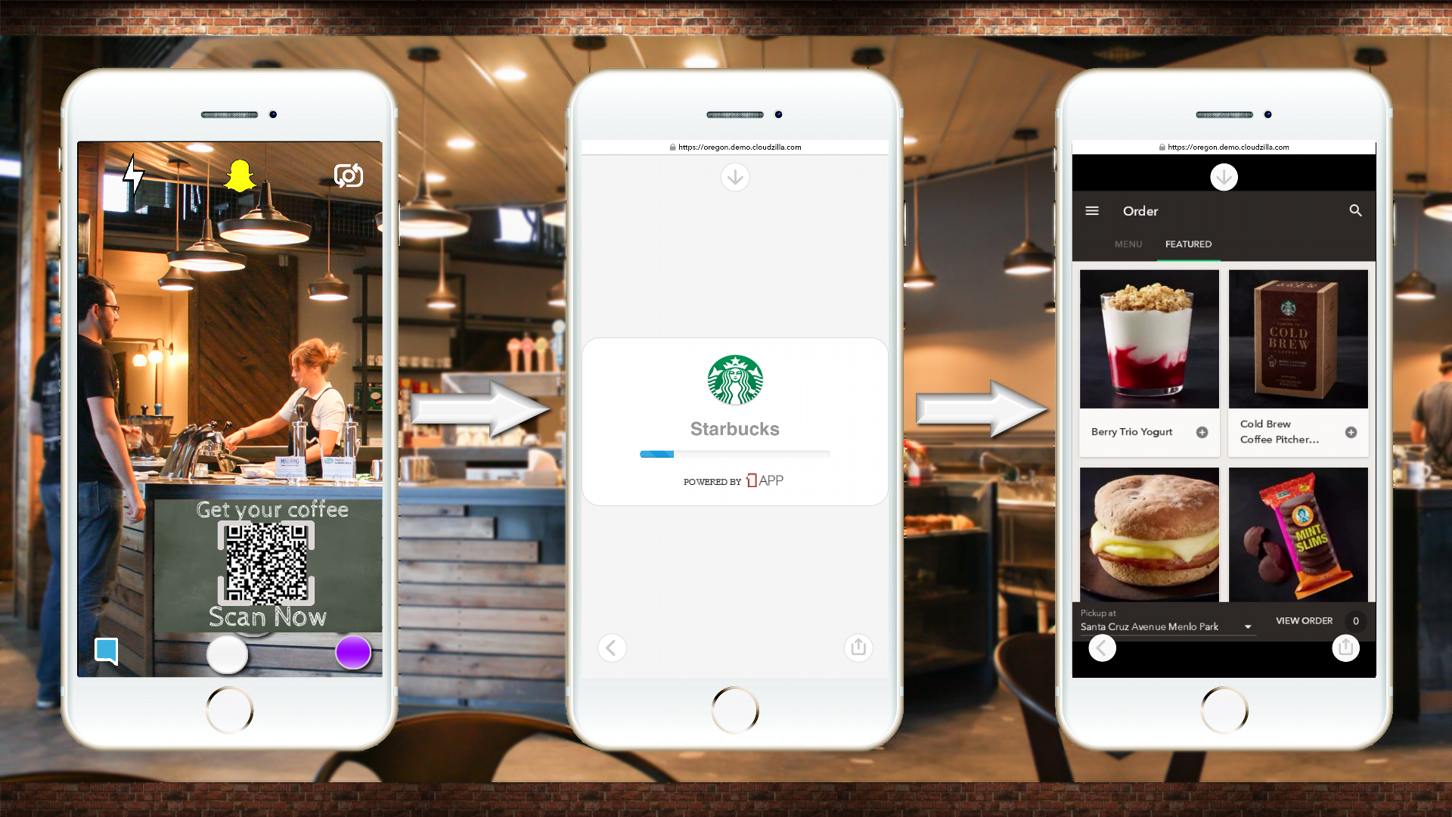
Challenges
The major challenge that Starbucks is dealing with is the current financial crisis in the world economy forcing them to call closures of many stores around the world.
Another challenge that Starbucks is dealing with is competitors. There are numerous coffee shops all over the world and being able to stand out to generate customers is important. Their main competitors are Dunkin Donuts, McDonald’s, and Nestle in the US and brands like Costa Coffee and Caffè Nero in the UK, the two major markets for Starbucks. It is important that for Starbucks to know their competitors and what they are currently doing.
Also Starbuck coffees are priced higher than other market competitors because of Starbucks only purchasing the highest quality coffee beans for their product, thus increasing the price of the drink giving the competitors a cost advantage over Starbucks.
Also Starbucks inadequate marketing strategy on advertising is a hindrance in the business growth opportunities. They prefer to build the brand by promoting the drinks cup-by-cup with customers. The advertisement ends until they drink the coffee, reducing the chances to attract valuable customers.

Slide 4
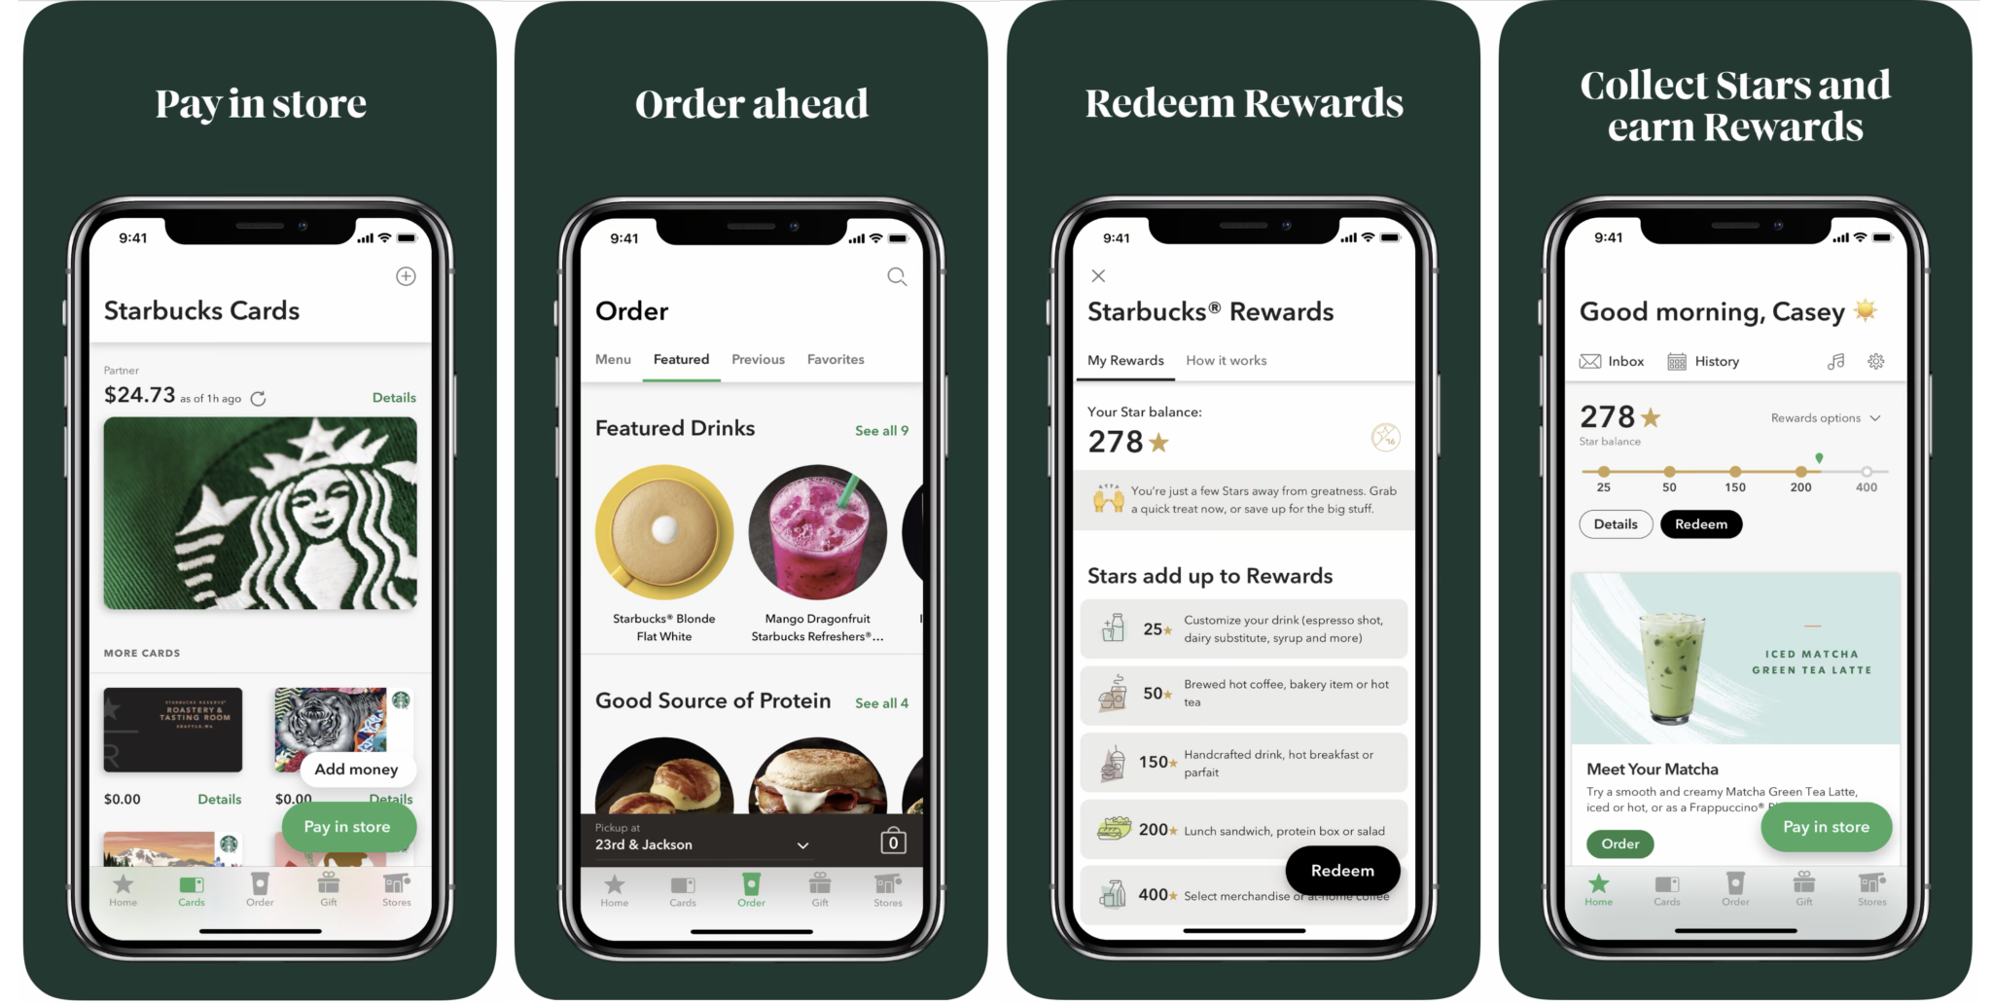
Starbucks App - Features
Download
Starbucks UK from the App store
Join
By setting up an account or log in using the customers existing details
Add money
To the customer’s account
Choose
And customise favourite beverages
Pick up
At selected locations
After acquiring numerous companies and opening countless stores all over the world, its owner expanded his plan to the mobile ecosystem, creating Starbucks app.

Slide 5
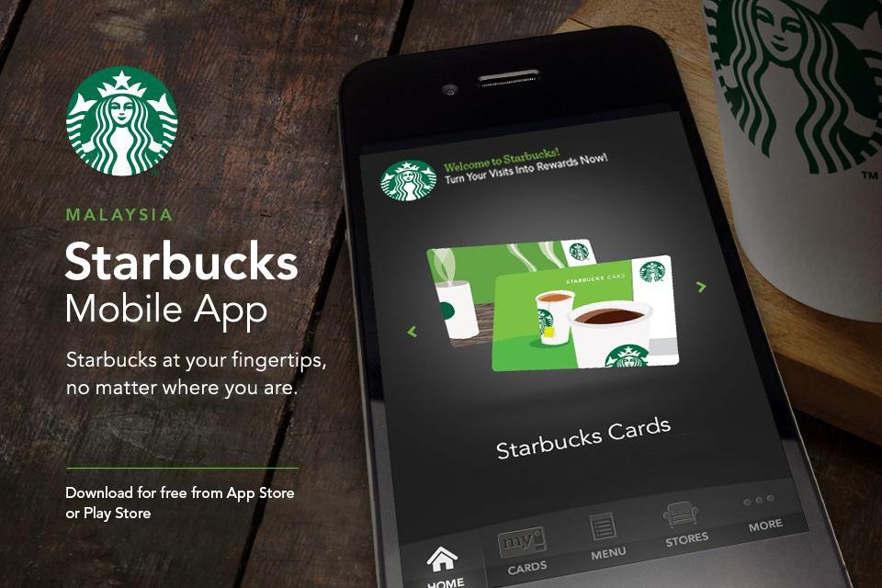
Starbucks App - Objectives
Starbucks' mission is "to inspire and nurture the human spirit – one person, one cup and one neighborhood at a time." The company aims to meet this goal through the development of a culture that embraces acceptance and is supportive of personal growth. As stated in the company's values, personal growth occurs through challenge and grows the company as well. This goal of acceptance extends into the company's diversity and accessibility policies. Company leaders are developed to lead multicultural teams of individuals with diverse perspectives and insights that ensure company growth and improved service delivery for customers. The company seeks to grow relationships with a diverse network of suppliers through strategic community relationship-building.
Starbucks also strives to be open and genuine in its interactions with suppliers, employees and customers. This is reflected in the company mission to drive performance without sacrificing individual and corporate humanity. The company practices this value through its community-building policies, which spur area development through investment. Starbucks values delivering the very best service and accepting responsibility when expectations are not met.

